Slide 1
Central Banking System
Presented by: Group 4
Md Fuad Anan (251014032)
Tapu Shikari (222014064 )
Sithi Saha (242014064 )
Jannatul Ferdous Lamia (242014001)
Maha Islam (252014045 )
Presented to:
Md Al-Amin Sheikh, PhD
University of Liberal Arts Bangladesh (ULAB)
$

Slide 2
Table of Contents
Central Bank and it’s work
Objective of the project
System Features
Use-Case Diagram
Class Diagram

Slide 3
What is Central Bank?
Our Project
A Java-based simulator that models the core operations of a central banking system.
A central bank is the main financial authority of a country responsible for:
Regulating commercial banks
Maintaining financial stability
Issuing loans to banks
Monitoring banking risks
Managing monetary policies
Supervising the banking sector
$
$

Slide 4
Project Objective
Main Objective
Make a Central Bank Simulator
$
Specific Objective
Register and Manage Banks
Control Money Supply
Monitor Banks
Manage national
User-friendly graphical interface
Generate reports
$

Slide 5
System Features
Commercial Bank Registration
Risk Monitoring
Register new banks
Assign unique Bank ID
Store bank information
Track liquidity levels
Monitor capital adequacy
Identify high-risk banks
Loan Management
Reporting System
Approve loans to banks
Track repayment status
Bank performance reports
Risk reports

Slide 6
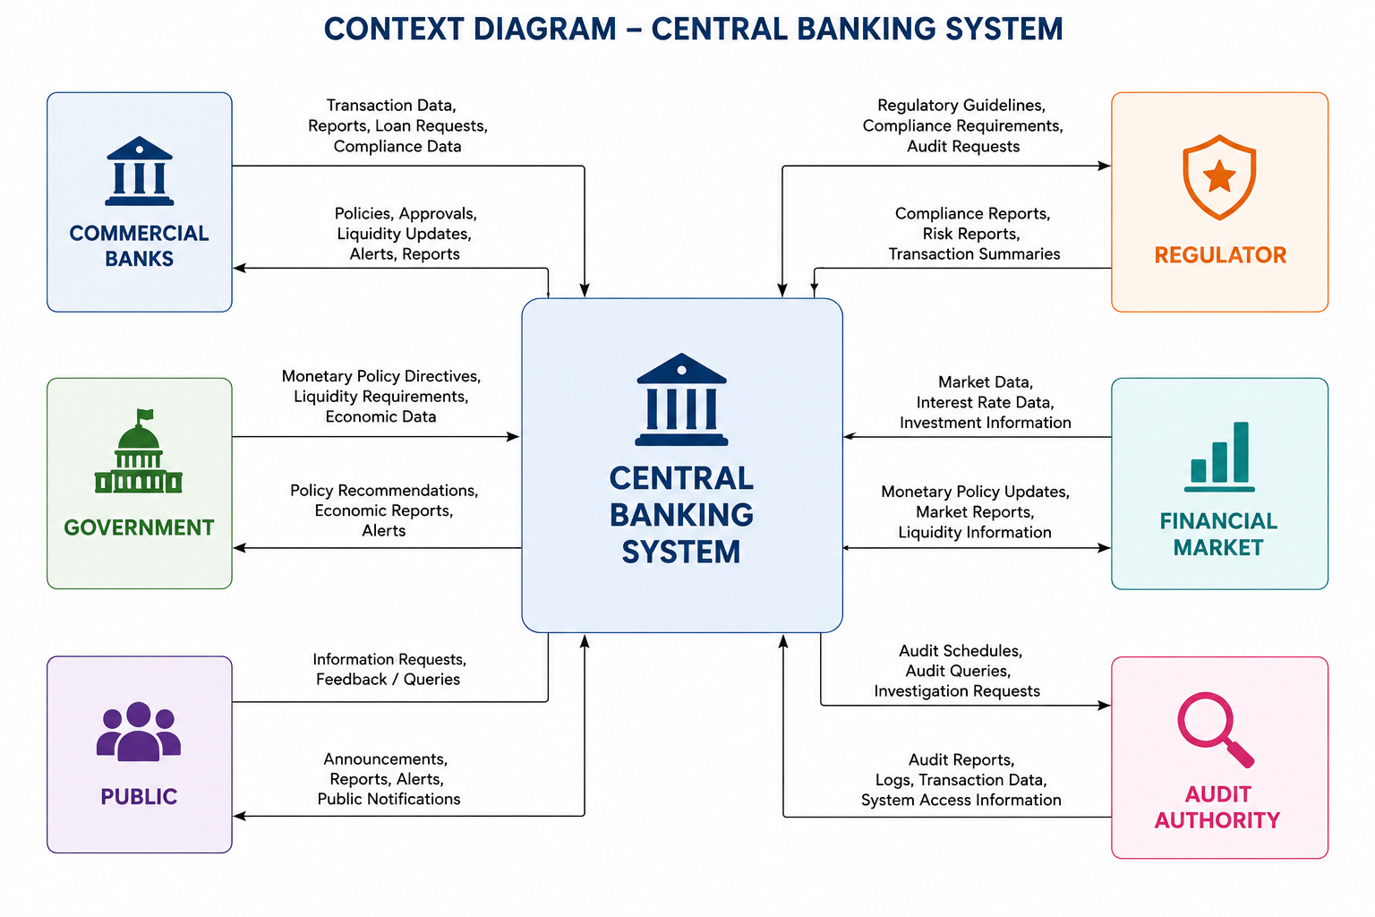

Slide 7
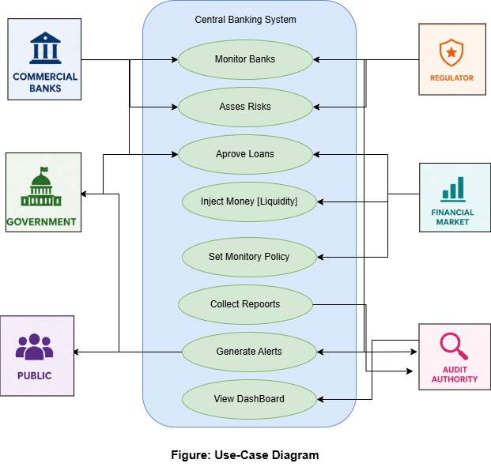

Slide 8
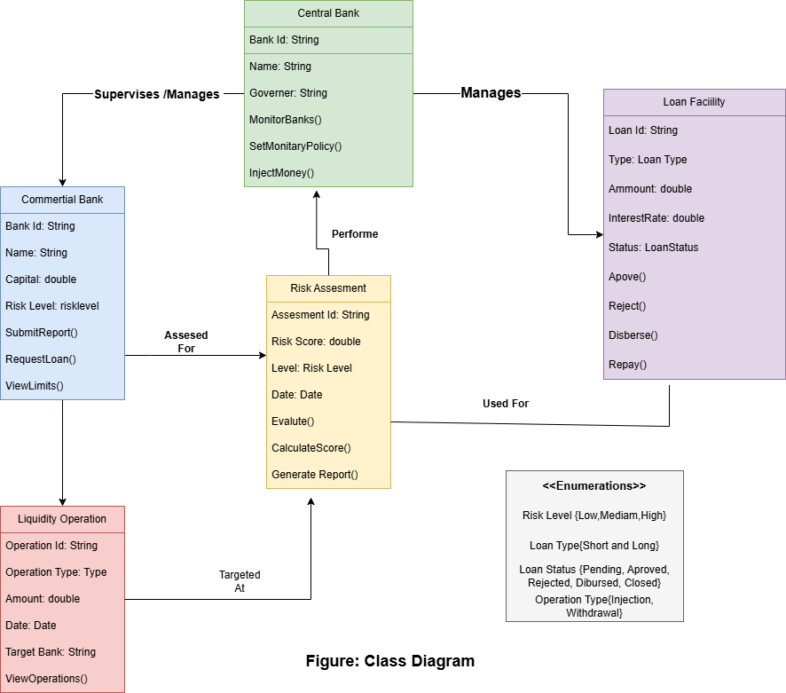

Slide 9
Conclusion
To build this project we need to understand and execute the following things:-
Understand the Central Bank's functions and it’s financial management
Develop a working Central Bank Simulator
Build a system that manages Commercial Banks, give loans, monitors risk
and generate report
Show how technology can improve the banking sector to be more efficient.

Slide 10
Thank You!
Any questions?
$
€
£

